Slide 1
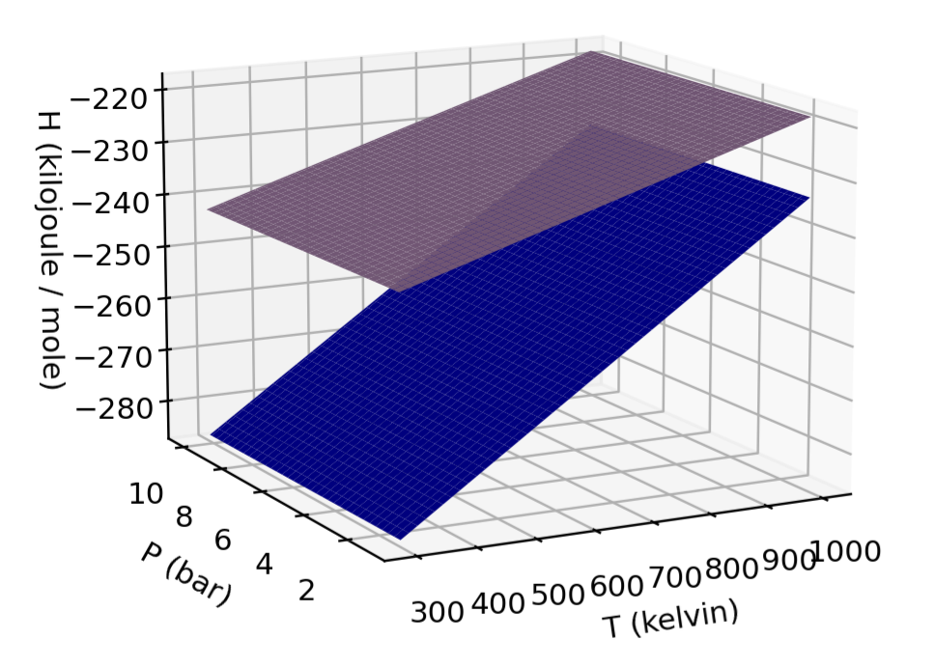
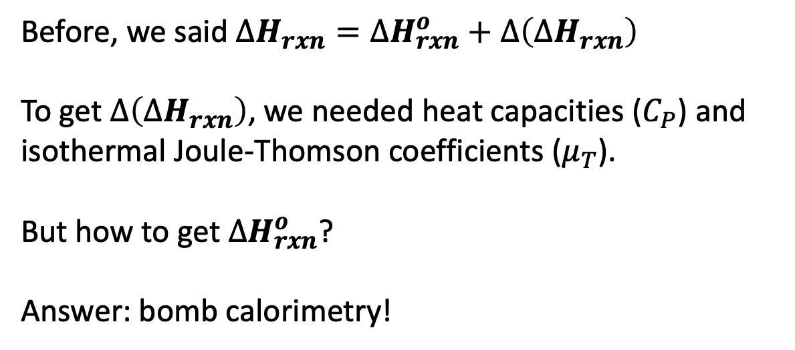
$∆H_{rxn}^{o}$
Before, we said $∆H_{rxn}=∆H_{rxn}^{o}+∆\left(∆H_{rxn}\right)$
To get $∆\left(∆H_{rxn}\right)$, we needed heat capacities ($C_{P}$) and isothermal Joule-Thomson coefficients ($μ_{T}$).
But how to get $∆H_{rxn}^{o}$?
Answer: bomb calorimetry!
$$products$$
$$reactants$$

